Slide 1
Listening Skills

Slide 2
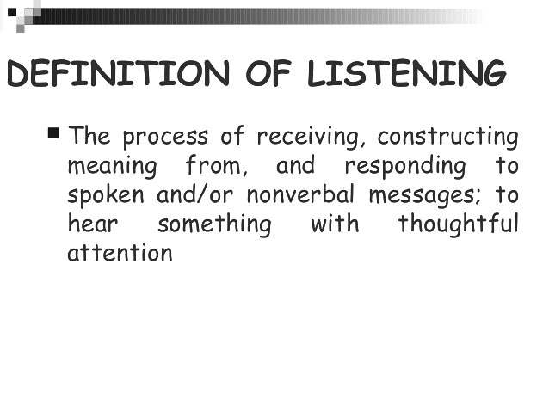
Listening

Slide 5
Listening Process

Slide 6
Listening Skills
The SOLER approach ( Egan, 2002)
Squarely face the person
Open posture
Lean towards the person
Eye contact
Relax
In your everyday listening, practise this approach and
see what the effects are.

Slide 7
Listening Skills - Tips
Listening also involves good body language and non-verbal communication and can give out many messages.
Good body language can put someone at ease before you say anything.
smiling and nodding
an open friendly confident posture
good eye contact but not staring

Slide 8
Listening Skills - Tips
Give people time to say what they want to. Avoid interrupting or finishing their sentence for them. It sends the message that you are more important, you know what they are going to say or you are in a rush.
Time for reflection: How do you know when someone is truly listening to you? How do you know when someone isn’t listening to you?
Notes:
Facilitator:
Activity 1: Listening

Slide 9
Types of Listening
Reflexive listening: this is what the listener hears in their own mind. It can lead to assumptions that are wrong.
External listening: this is what the listener hears from the person, the words they say and how they say them – how they see things.
Intuitive listening : this is what the listener feels about the person. He/she attends to the patterns and areas that are avoided.
Holding silence: Giving people time to think and then speak. This is hard to do – ‘hold your fire.’

Slide 10
Blocks to effective listening
There are blocks to listening. Be aware of these in yourself and in others:
Poor listeners may demonstrate these behaviours:
knowing the answer
trying to be helpful
trying to influence or impress
making assumptions
only hearing what you want to hear
daydreaming
being in a hurry
looking for points to argue with
feeling nervous or vulnerable
Notes:
Facilitator:
Poor listening tends to create negative effects such as resistance and annoyance.
Poor listening can de-motivate and ‘put-off’ the speaker.

Slide 11
Negative listening habits to avoid:
The FAKER: mind is elsewhere
The INTERRUPTER
The INTELLECTUAL or LOGICAL LISTENER: interprets and judges
The REBUTTAL maker: looking for a mistake, an argument or dismissal
The ADVICE giver: can be good but can be a turn off

Slide 12
Common Listening issues:
Tuning in and out – on average we think approximately four times faster than we speak, leading to listeners tuning out, using the space to address their own thoughts, to daydream rather than staying tuned into the listener.
The glazed look – there are times when an individual will concentrate on the speaker rather than on what is being said for whatever reason, bringing on that glazed look on the face of those listening. We can all tell when this is happening.

Slide 13
Common Listening issues:
Becoming heated – certain trigger phrases, words and views may cause listeners to feel as if they should dive in with their own opinions. It is better to hold back on this even if you disagree.
Giving space Avoid the temptation to rush in and fill these, as we all have differing periods of reflection and thinking. Silence can often be an indication that thinking is going on.

Slide 14
Active listening:
People like being listened to as it demonstrates respect. As a good listener you will show that you are attentive and that you are interested in what the speaker is saying.
Resist the temptation to interrupt. Using silence gives the speaker space and time to think about, construct and say what they mean.
Encourage the speaker to explore their thoughts. Make it clear that you are interested in helping them to develop their thoughts and ideas.

Slide 15
Active listening:
The active listener will notice any misconceptions or prejudices there may be. The active listener will be skilful in reflecting back what the speaker has said. This helps clarify understanding and lets the speaker know that you are focusing on what they mean. This also helps the speaker clarify complex thinking and provides an opportunity for them to elaborate.
When you reflect back, it enables the speaker to confirm or correct your understanding. Mirroring what the speaker has said and using the same words is very helpful.

Slide 16
Some useful phrases for active listening:
Confirming:
Let me confirm...
Can I make sure I understand what you’ve said..?
Can I just check?
Summarising:
Can I summarise what you’ve said please?
I think you said...
Checking:
Is that right?
Have I understood you correctly?
Notes:
Activity 2:Active listening role play
Emphasise that the phrases listed in this slide are just examples of possible phrases. Adapt the tone/ language to fit in with the tone of the conversation.

Slide 17
To summarise, good listening skills include:
Paying attention: non-verbal, verbal and allowing people to finish, being aware of body language
Checking understanding: paraphrasing, summarising, reflecting back the words.
Allowing for silence: don’t rush in or interrupt. Allow reflection to take place.
Encourage exploration: “tell me more about that.” Make it clear that you want to support the person in reflecting and understanding.

